Slide 1
AUTOMATED LEAVE MANAGEMENT SYSTEM
St. Joseph’s College,Devagiri (Autonomous)
Final Phase Project Review-2022
Presented by:
Abin Sheldon Jimmington (19USCS15)
Nadha Ashraf (19USCS36)
Pranoy K. C. (19USCS30)
Guided by: Miss Anjana T.K.
Department of Computer Science

Slide 2
1. | Synopsis
2. | Existing System
3. | Disadvantages of Existing System
4. | Proposed System
5. | Advantages of Proposed System
6. | Technologies Used
7. | Hardware and Software Specifications
8. | ER Diagram
9. | Data Flow Diagram
10. | Table Design
11. | Input Output Forms
12. | Conclusion
Table of Contents

Slide 3
SYNOPSIS
An online leave management system is a web-based leave management application that automates every step of the employee leave management process without compromising on functionality.
Unlike on-premise leave management tools, an online leave management system gives employees the freedom to apply, approve, reject, and manage leave requests from any place, any time, and from any device.

Slide 4
ABOUT OUR PROJECT
Our proposed system is an automated leave management system that computerizes the process of applying for and approving a leave of absence and making necessary changes to the schedule accordingly.
The system stores the timetables for all the classes before hand. A faculty member applies for a leave and once leave is approved, the system automatically adjusts the timetable to accommodate the absence of that faculty member by assigning it to another member who is available at that time.

Slide 5
This avoids the hassle of manually examining the timetables and assigning substitute teachers based on availability. This system thus ensures that no class is left unmonitored during class hours.

Slide 6
EXISTING SYSTEM
The existing system of leave management requires the employees to apply for leave manually by personally contacting the heads of their departments.
The HOD then approves the leave application and manually alters the timetable to accommodate the absence of that teacher by distributing his or her classes to other available faculty members .

Slide 7
DISADVANTAGES OF EXISTING SYSTEM
Requires more man power.
Time consuming.
Consumes large volume of paper work.
Needs manual calculations.
Larger scope for manual errors.
To avoid all these limitations and make the working more accurate, the system needs to be computerized in a better way.

Slide 8
PROPOSED SYSTEM
Our proposed system is an automated leave management system that computerizes the process of applying for and approving a leave of absence and making necessary changes to the schedule accordingly.
The system stores the timetables for all the classes before hand. A faculty member applies for a leave and once leave is approved, the system automatically adjusts the timetable to accommodate the absence of that faculty member by assigning it to another member who is available at that time.
This avoids the hassle of manually examining the timetables and assigning substitute teachers based on availability. This system thus ensures that no class is left unmonitored during class hours.

Slide 9
ADVANTAGES OF PROPOSED SYSTEM
More efficient .
Less time consuming.
This web application can be accessed at anytime and anywhere.
Provides mobility.
Since the timetables automatically alters itself, it requires less manual labour.
Less scope for human error.

Slide 10
ORGANISATIONAL PROFILE
RISS technologies, an ISO 9001:2008 certified company focuses on transforming and running business processes and operations including those that are complex and industry-specific. Our loom is distinctive: through an unbiased, agile combination of smarter process science, targeted technology and advanced analytics, we help our clients become more competitive by making their enterprises more intelligent: adaptive, innovative, globally effective, and connected to their own clients.

Slide 11
TECHNOLOGIES USED
Python
Framework: Flask

Slide 12
HARDWARE AND SOFTWARE SPECIFICATIONS
Software Requirements
Front End : Dreamweaver CS6, Java Script
Back End : Pycharm, SQLyog, Wampserver
Operating system : Windows 7 or above
Hardware Requirements
Processor : 64 bit RAM : Min 3 GB Hard Disk : 10 GB

Slide 13

ENTITY-RELATIONSHIP DIAGRAM

Slide 14
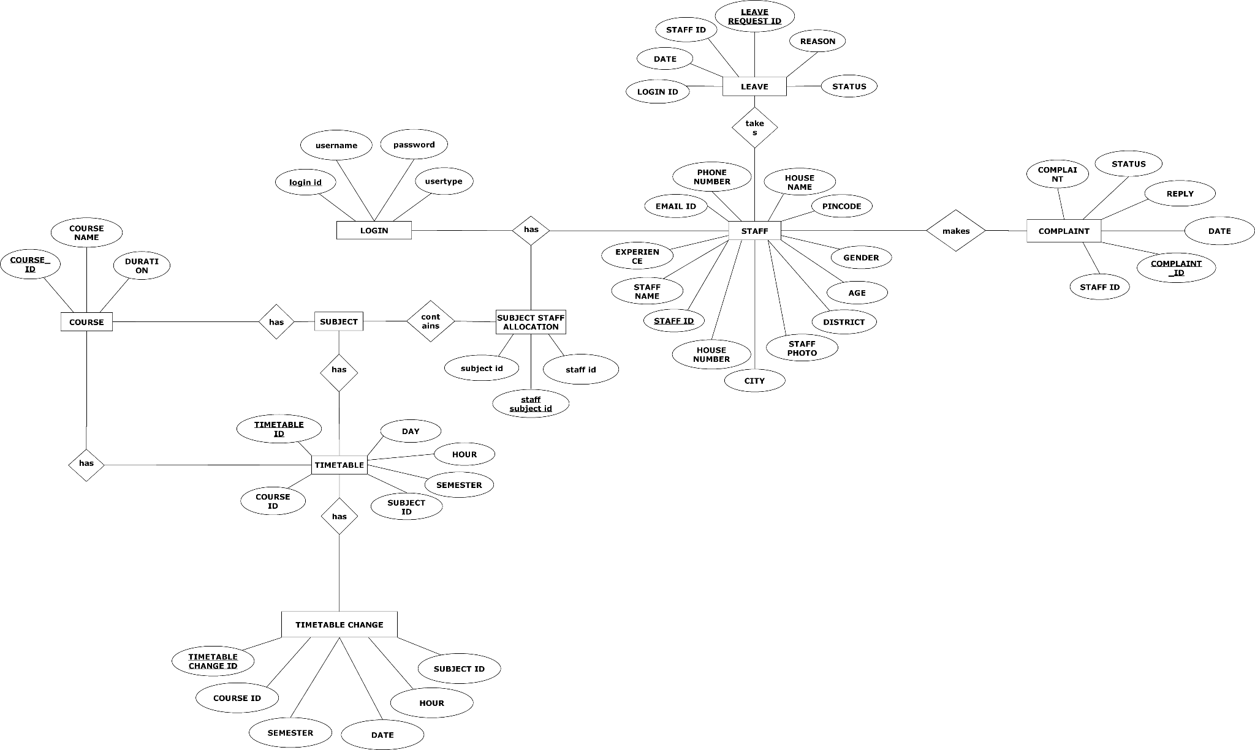

Slide 15

DATA FLOW DIAGRAM

Slide 16
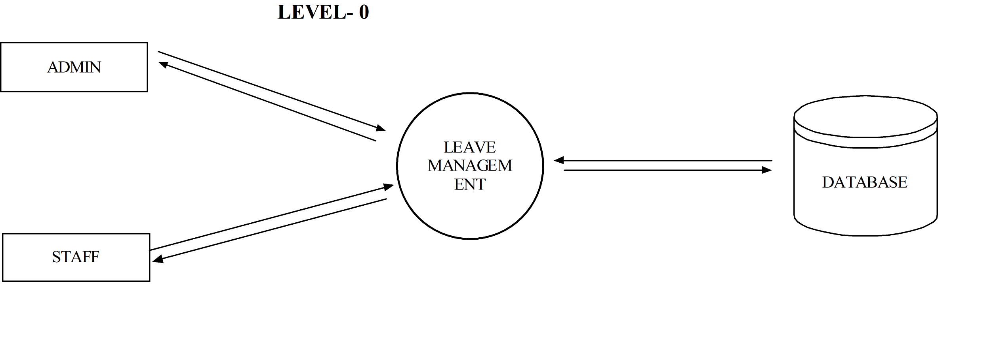
LEVEL-0

Slide 17
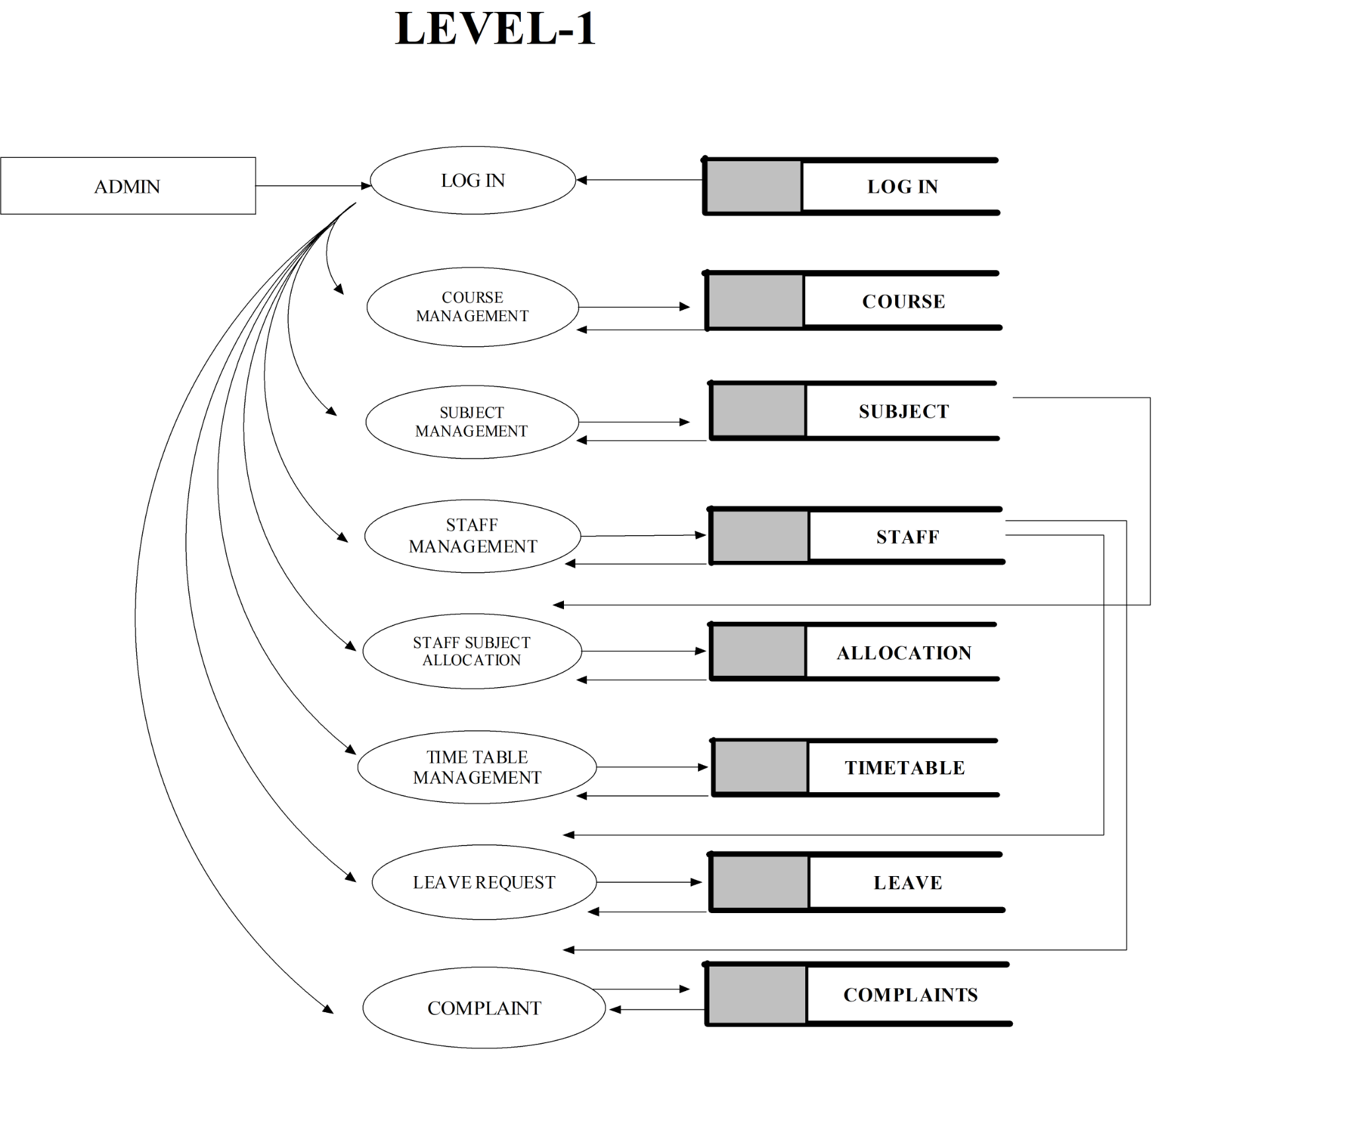

Slide 18
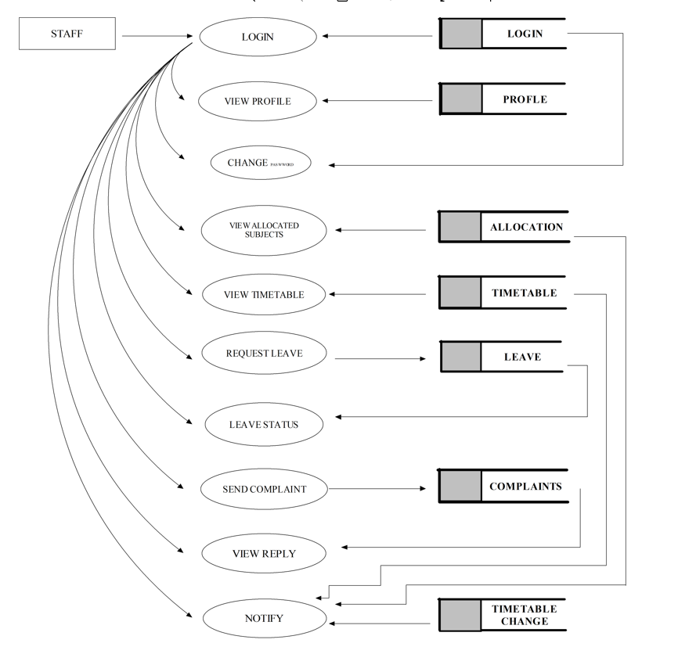
LEVEL-2

Slide 19

TABLE DESIGN

Slide 20
LOGIN TABLE
SL NO. | FIELD NAME | DATATYPE | CONSTRAINTS
1. | Login ID | varchar | Primary key
2. | Username | varchar | Not NULL
3. | Password | varchar | Not NULL
4. | Usertype | varchar | Not NULL

Slide 21
COURSE
SL NO | FIELD NAME | DATATYPE | CONSTRAINTS
1. | Course ID | varchar | Primary Key
2. | Course Name | varchar | Not NULL
3. | Duration | int | Not NULL

Slide 22
SUBJECT
SL NO | FIELD NAME | DATATYPE | CONSTRAINTS
1. | Subject ID | varchar | Primary key
2. | Subject Name | varchar | Not NULL
3. | Course ID | varchar | Foreign Key
4. | Semester | varchar | Not NULL

Slide 23
STAFF
SL NO | FIELD NAME | DATATYPE | CONSTRAINTS
1. | Staff ID | varchar | Primary Key
2. | Staff Name | varchar | Not NULL
3. | Experience | int | Not NULL
4. | Staff Photo | file | Not NULL
5. | Age | int | Not NULL
6. | Gender | varchar | Not NULL

Slide 24
7. | Mail ID | varchar | Not NULL
8. | Phone Number | int | Not NULL
9. | Login ID | varchar | Foreign Key
10. | House Name | Varchar | Not NULL
11. | House Number | Varchar | Not NULL
12. | City | Varchar | Not NULL
13. | Pincode | int | Not NULL

Slide 25
SUBJECT STAFF ALLOCATION
SL NO | FIELD NAME | DATATYPE | CONSTRAINTS
1. | Staff Subject ID | varchar | Primary key
2. | Subject ID | varchar | Foreign key
3. | Staff ID | varchar | Foreign key

Slide 26
TIMETABLE
SL NO | FIELD NAME | DATATYPE | CONSTRAINTS
1. | Timetable ID | varchar | Primary key
2. | Day | Varchar | Not NULL
3. | Hour | Varchar | Not NULL
4. | Course ID | Varchar | Foreign Key
5. | Semester | varchar | Not NULL
6. | Subject ID | varchar | Foreign Key

Slide 27
LEAVE
SL NO | FIELD NAME | DATATYPE | CONSTRAINTS
1. | Leave Request ID | varchar | Primary Key
2. | Staff ID | varchar | Foreign Key
3. | Date | date | Not NULL
4. | Reason | varchar | Not NULL
5. | Status | varchar | Not NULL

Slide 28
COMPLAINT
SL NO | FIELD NAME | DATATYPE | CONSTRAINTS
1. | Complaint ID | varchar | Primary Key
2. | Staff ID | varchar | Foreign Key
3. | Date | date | Not NULL
4. | Complaint | Varchar | Not NULL
5. | Reply | Varchar | Not NULL
6. | Status | varchar | Not NULL

Slide 29

INPUT/OUTPUT FORM DESIGN- MODULE I (ADMIN)

Slide 30
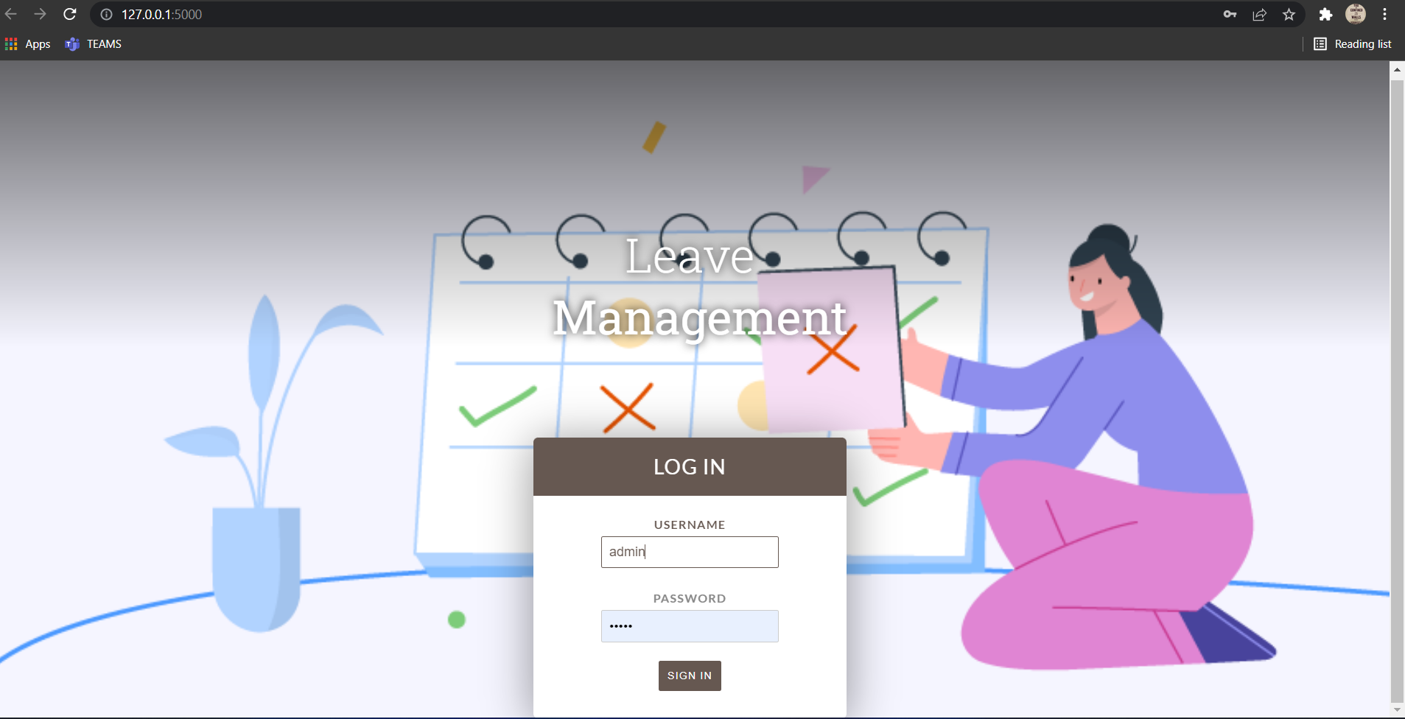
LOGIN PAGE

Slide 31
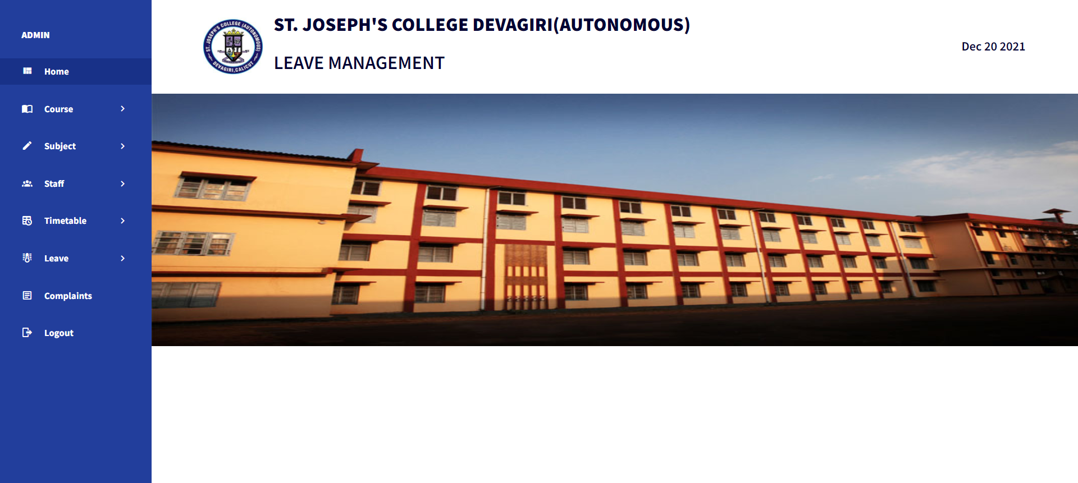
ADMIN HOME PAGE

Slide 32
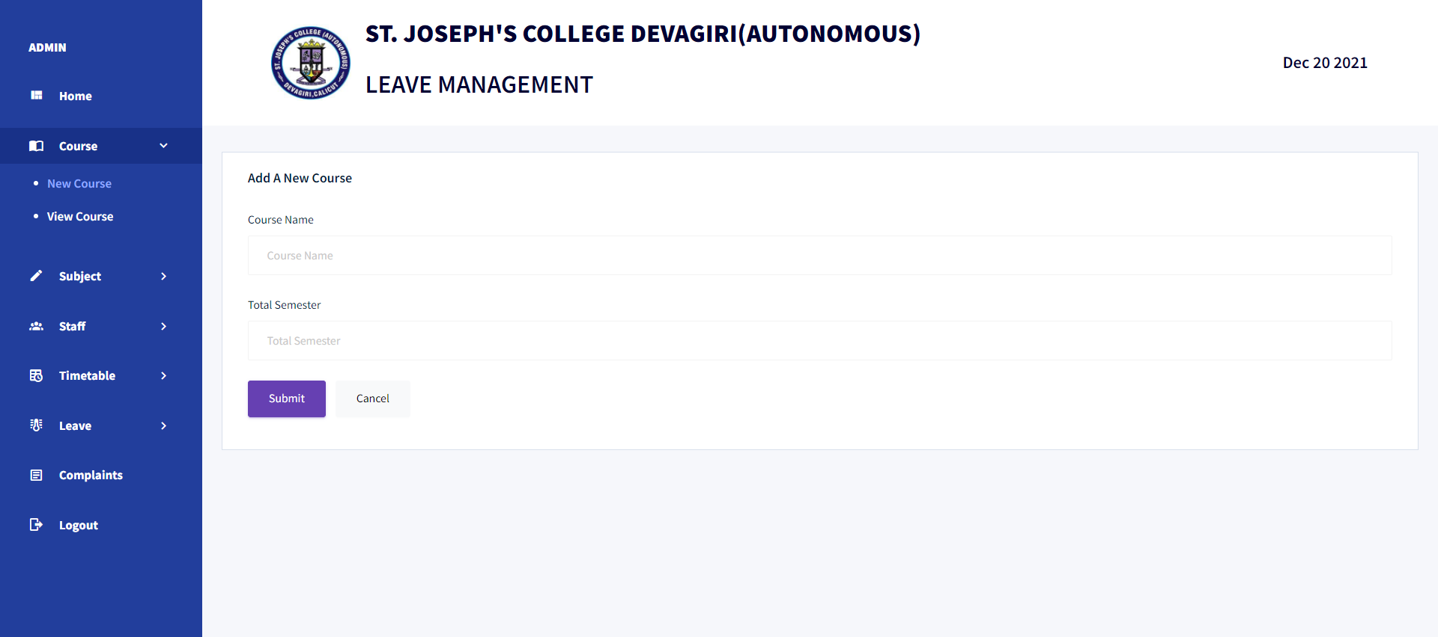
ADD COURSE PAGE

Slide 33
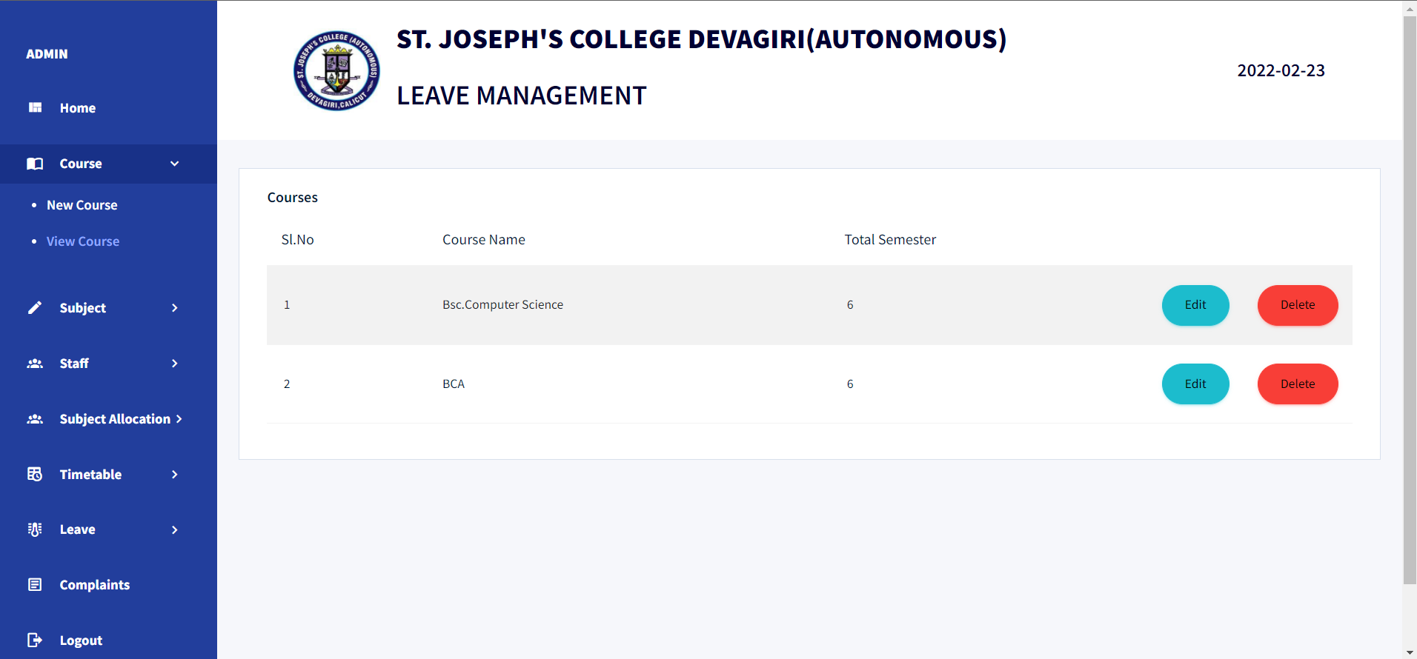
VIEW COURSES

Slide 34
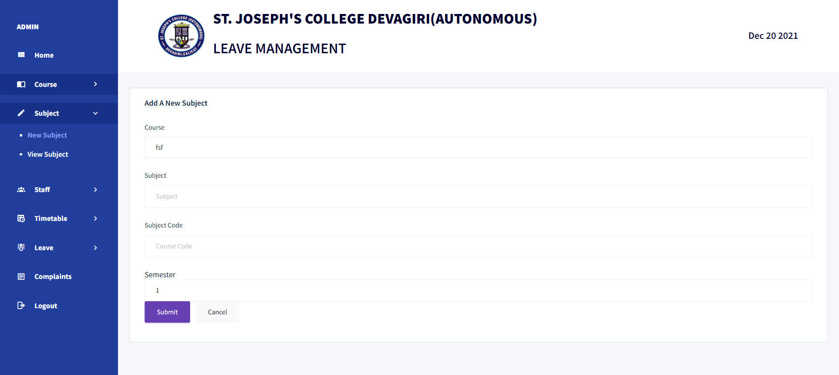
ADD NEW SUBJECT PAGE

Slide 35
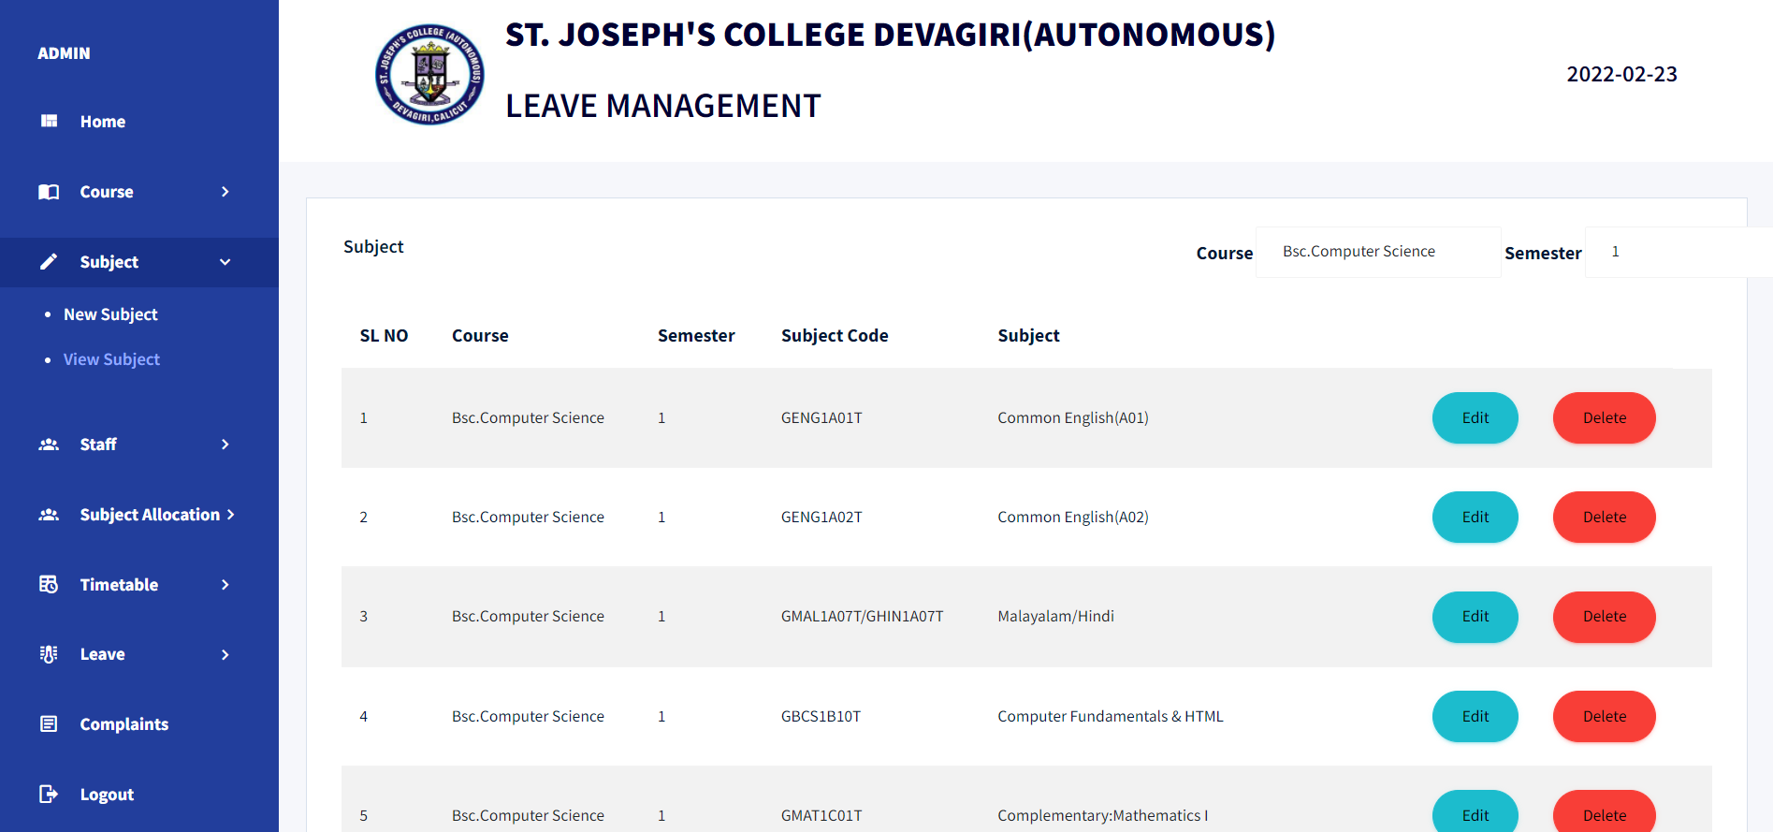
VIEW SUBJECTS

Slide 36
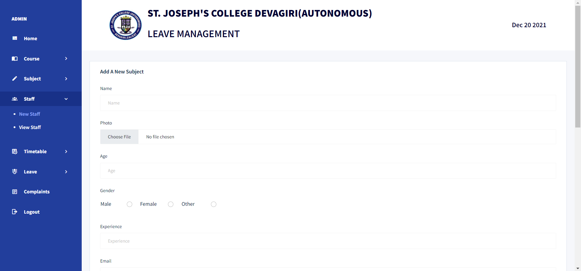
ADD NEW STAFF

Slide 37
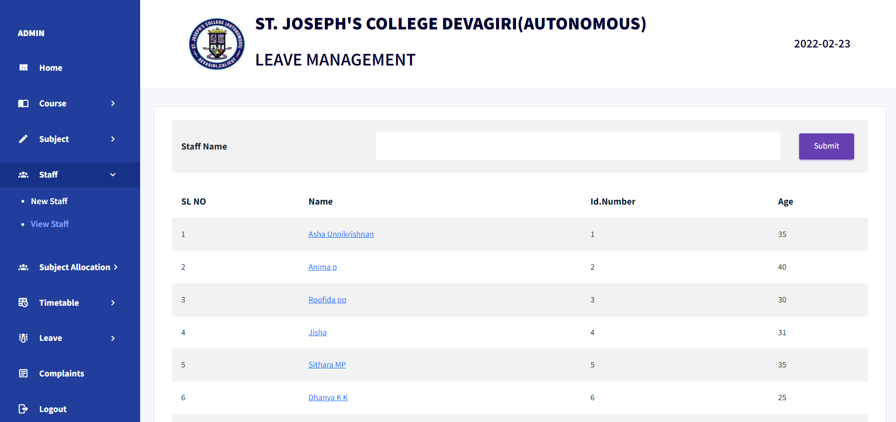
VIEW LIST OF STAFF

Slide 38
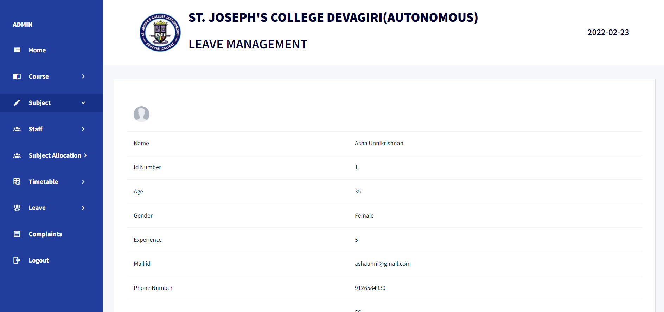
VIEW STAFF DETAILS

Slide 39
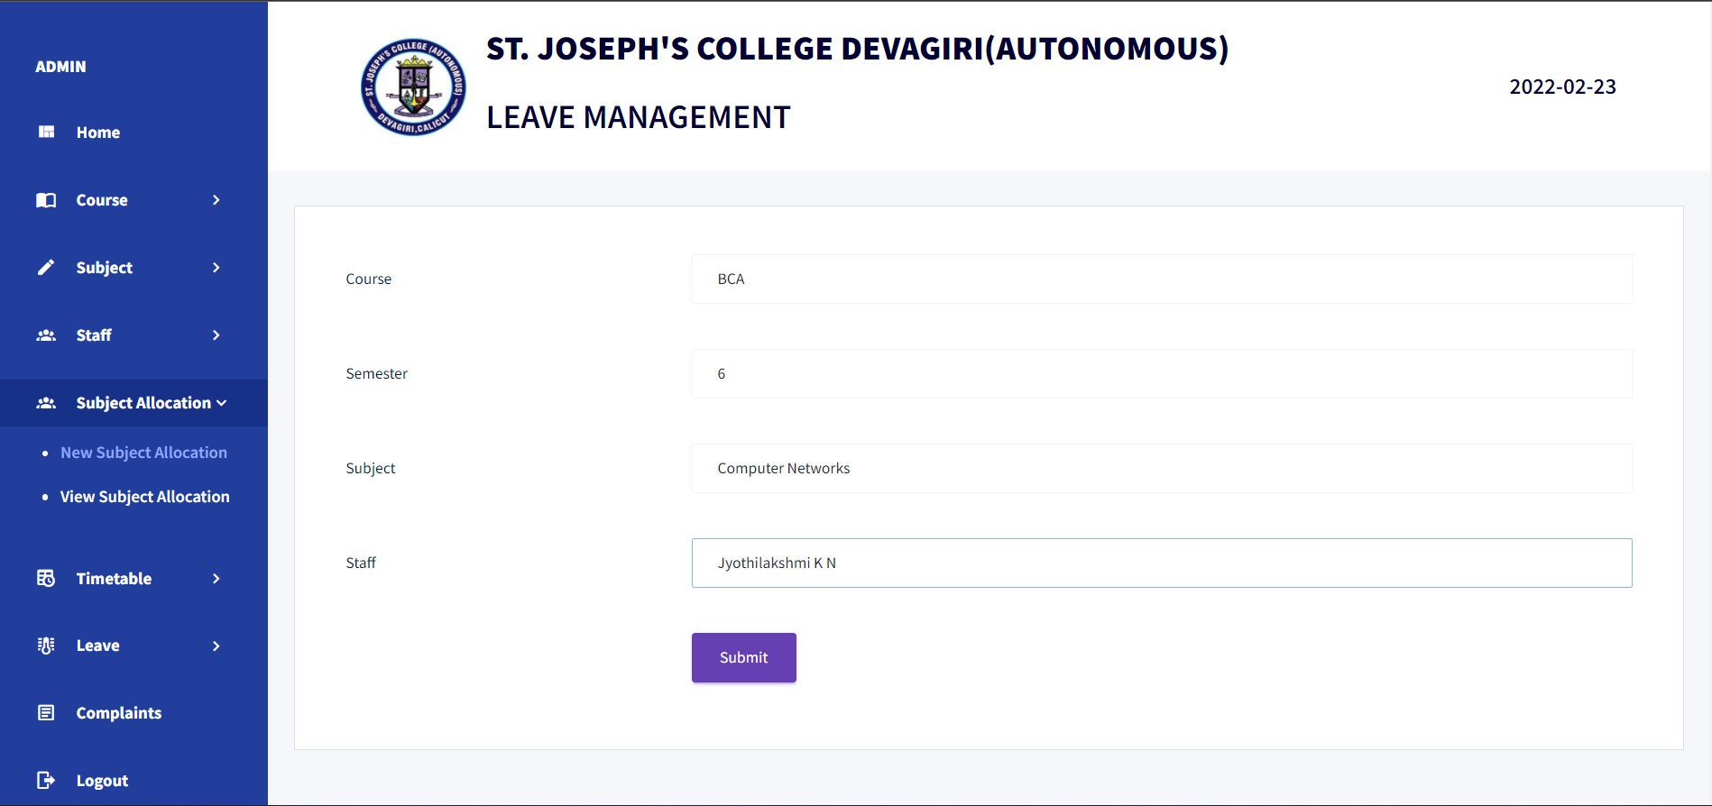
ALLOCATE SUBJECTS TO STAFF

Slide 40
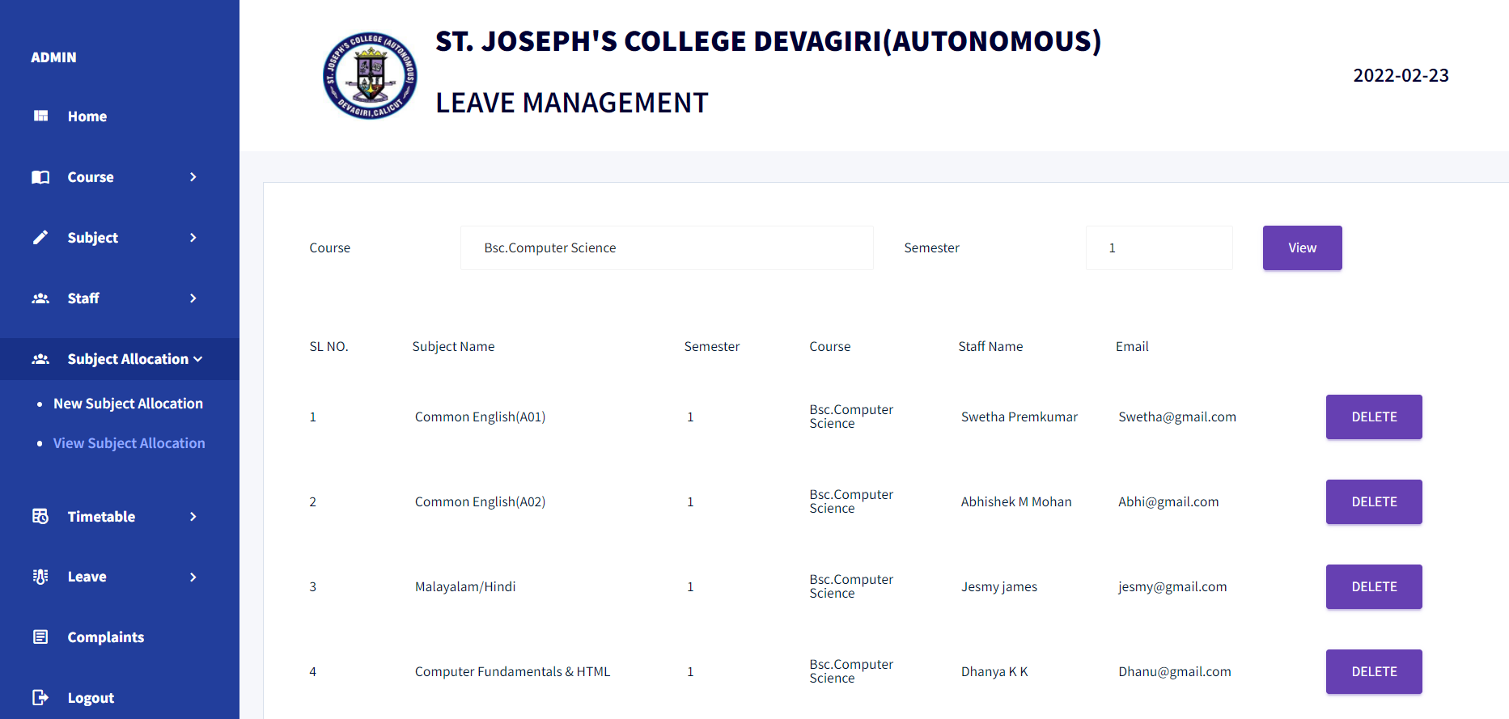
VIEW SUBJECT ALLOCATION

Slide 41
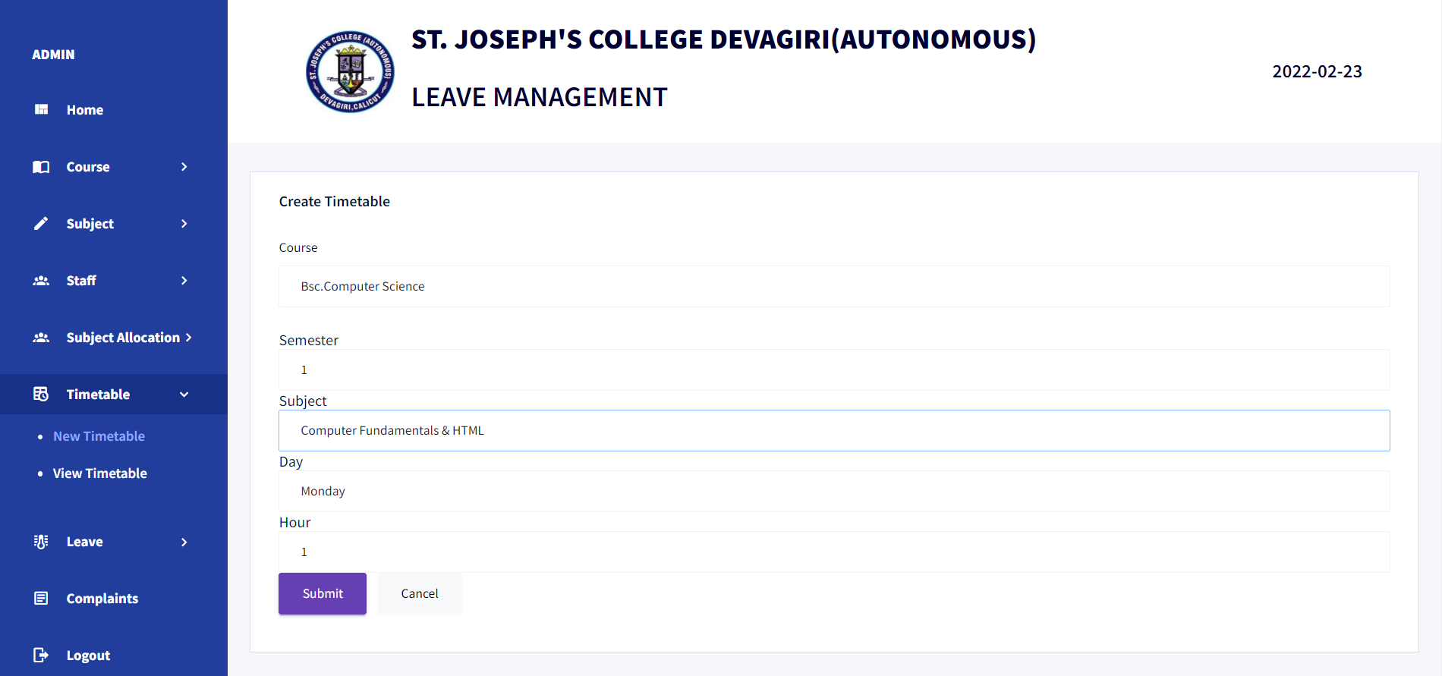
CREATE TIMETABLE

Slide 42
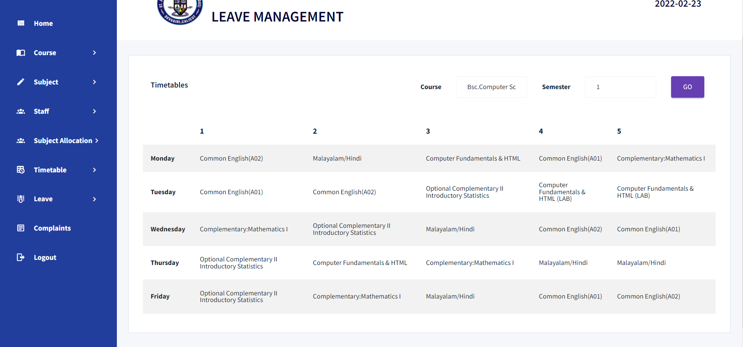
VIEW TIMETABLE

Slide 43
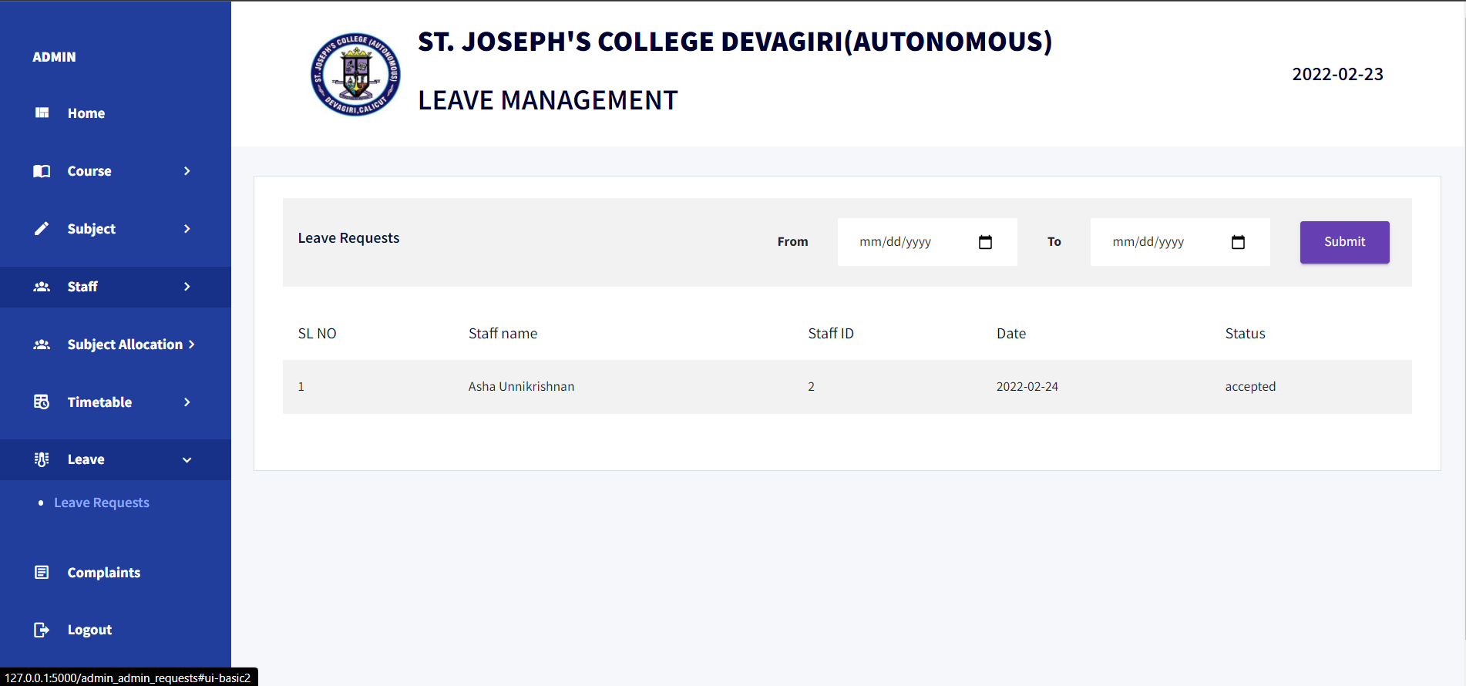
VIEW LEAVE REQUESTS

Slide 44
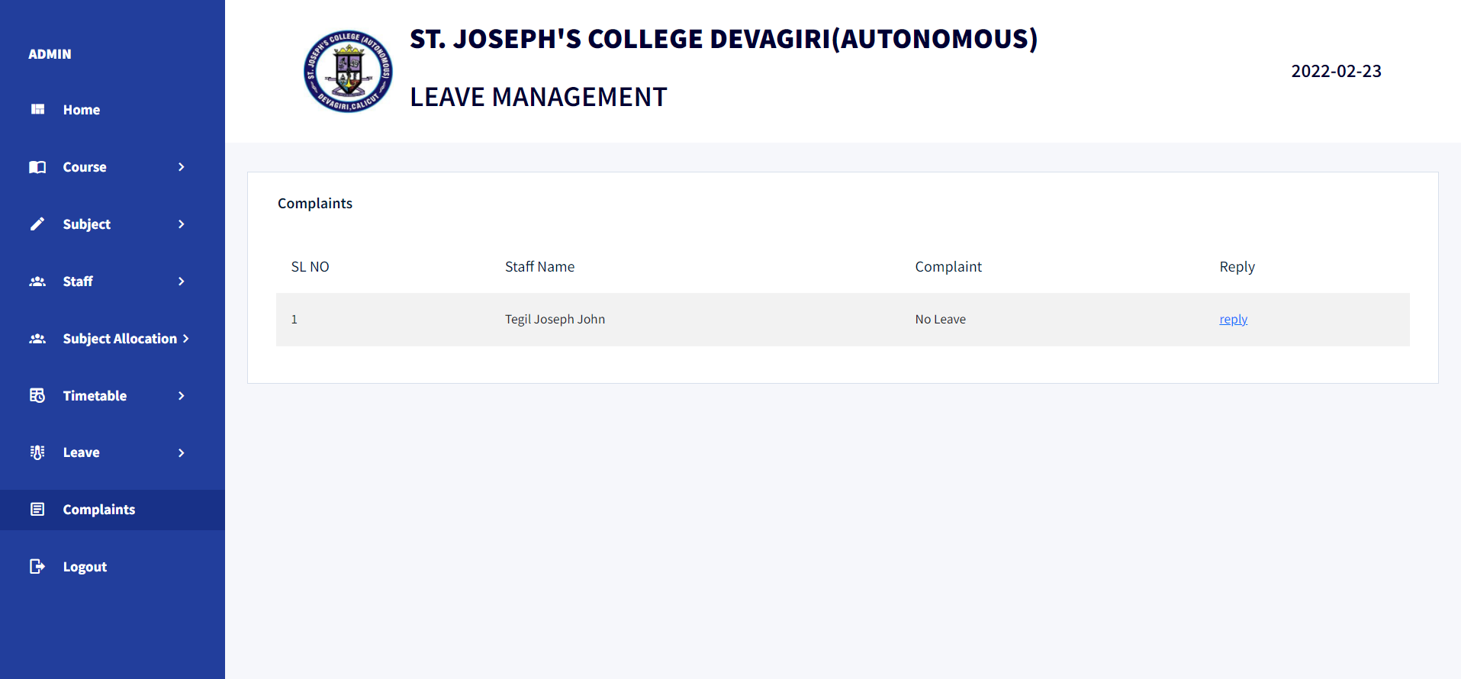
VIEW COMPLAINTS FROM STAFF

Slide 45
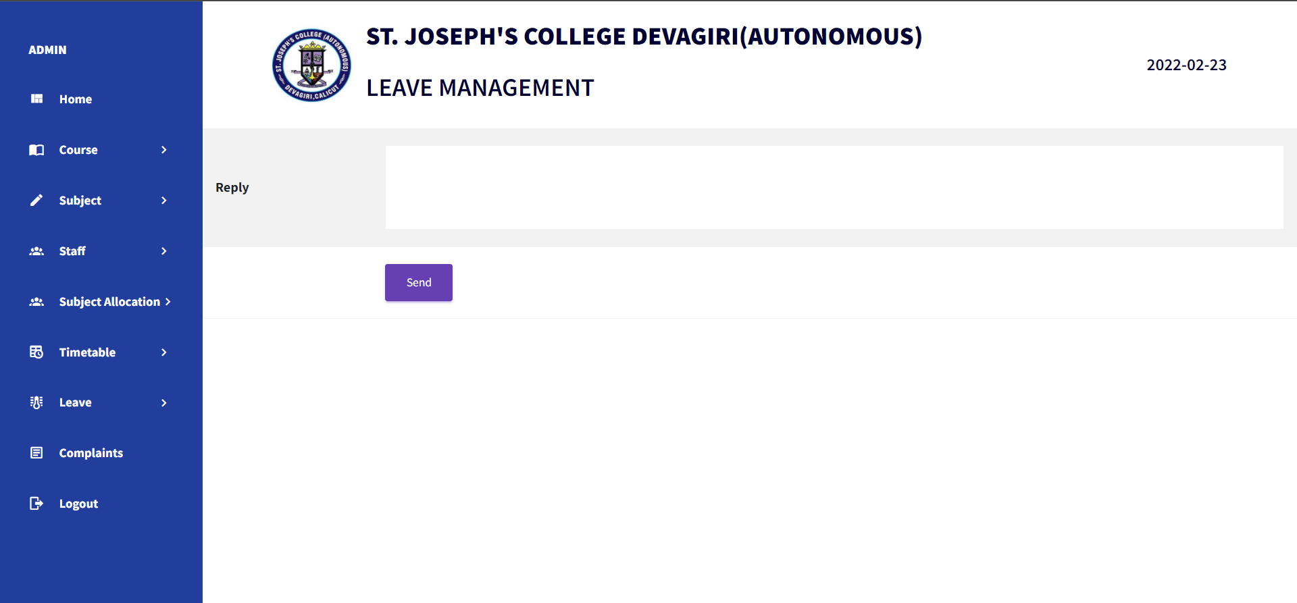
REPLY TO COMPLAINTS

Slide 46
INPUT/OUTPUT FORM DESIGN-
MODULE II (STAFF)

Slide 47
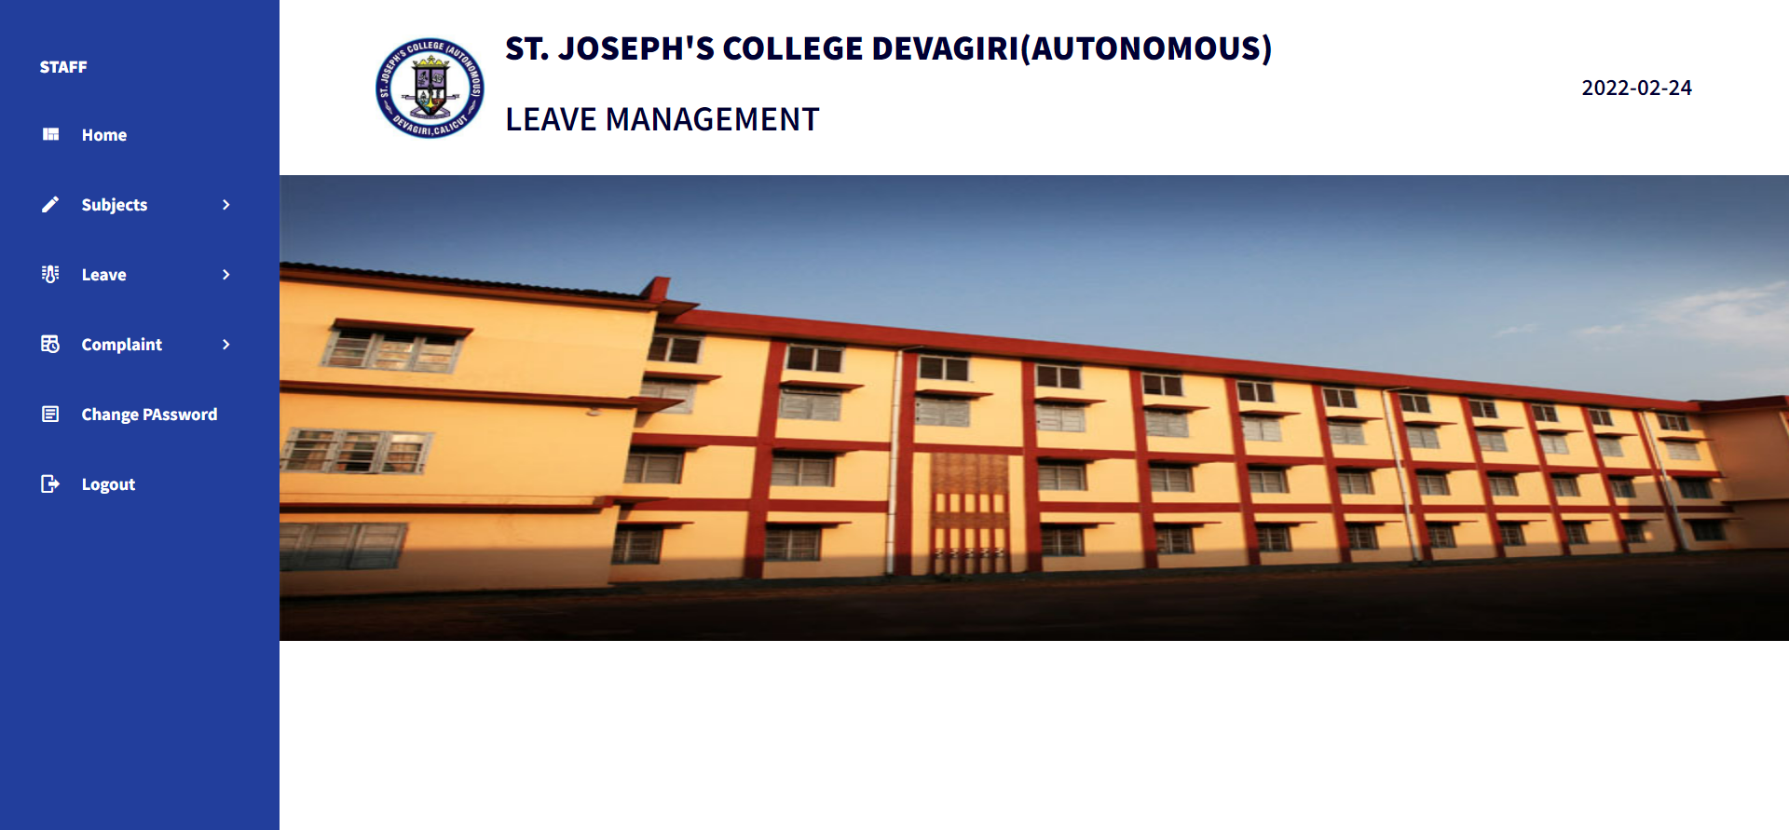
STAFF HOME PAGE

Slide 48
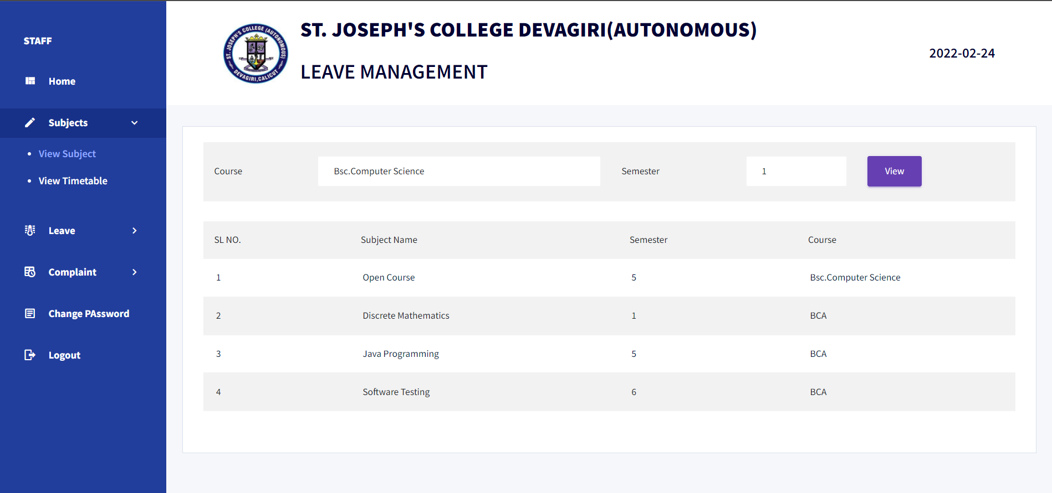
VIEW SUBJECTS

Slide 49
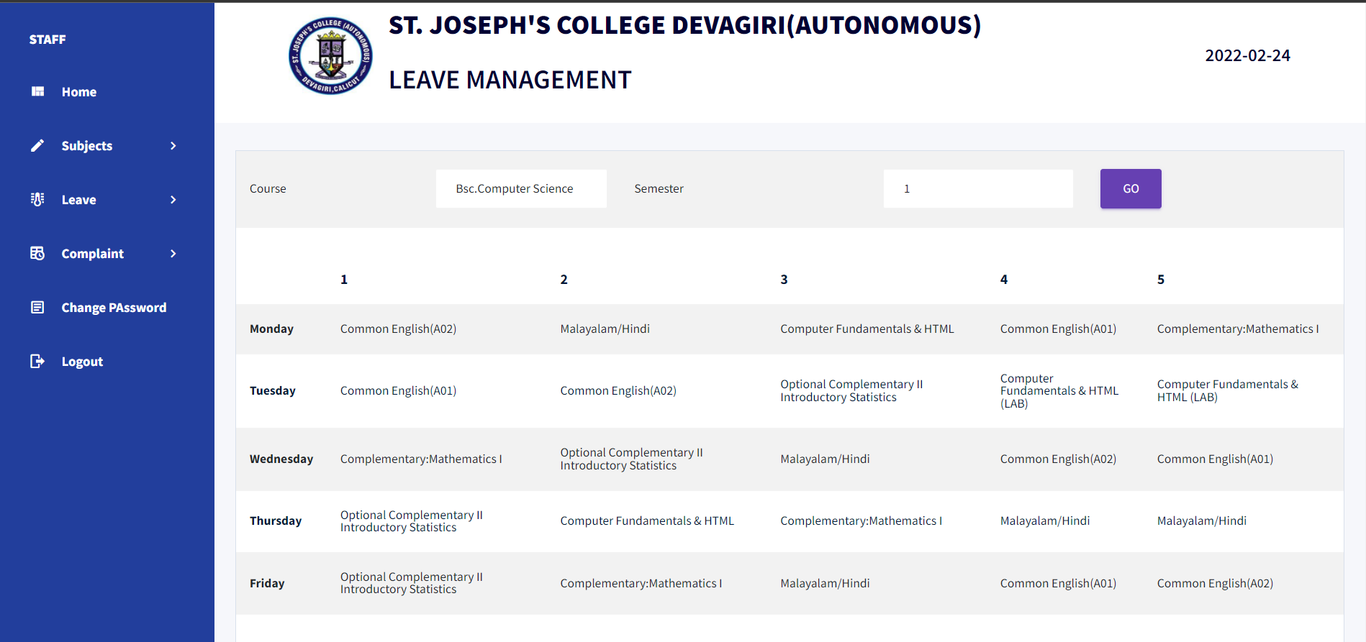
VIEW TIMTABLE

Slide 50
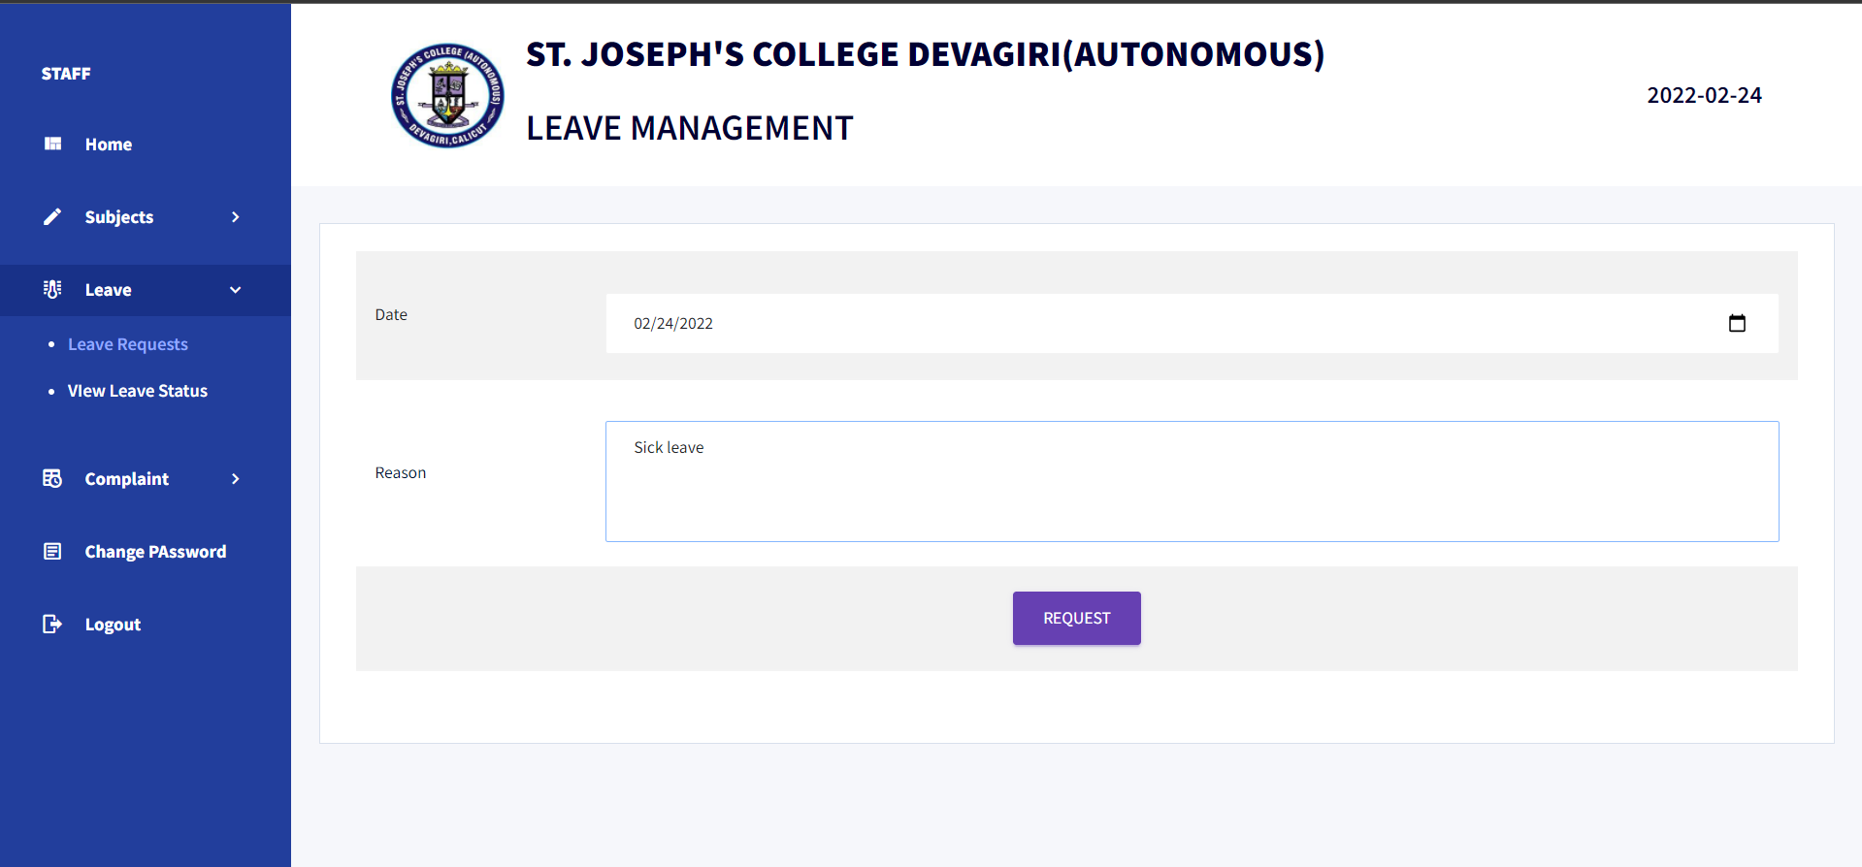
APPLY FOR LEAVE

Slide 51
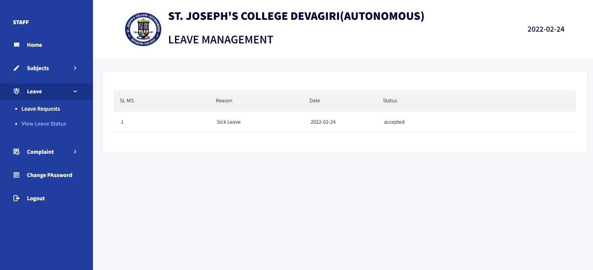
VIEW LEAVE STATUS

Slide 52
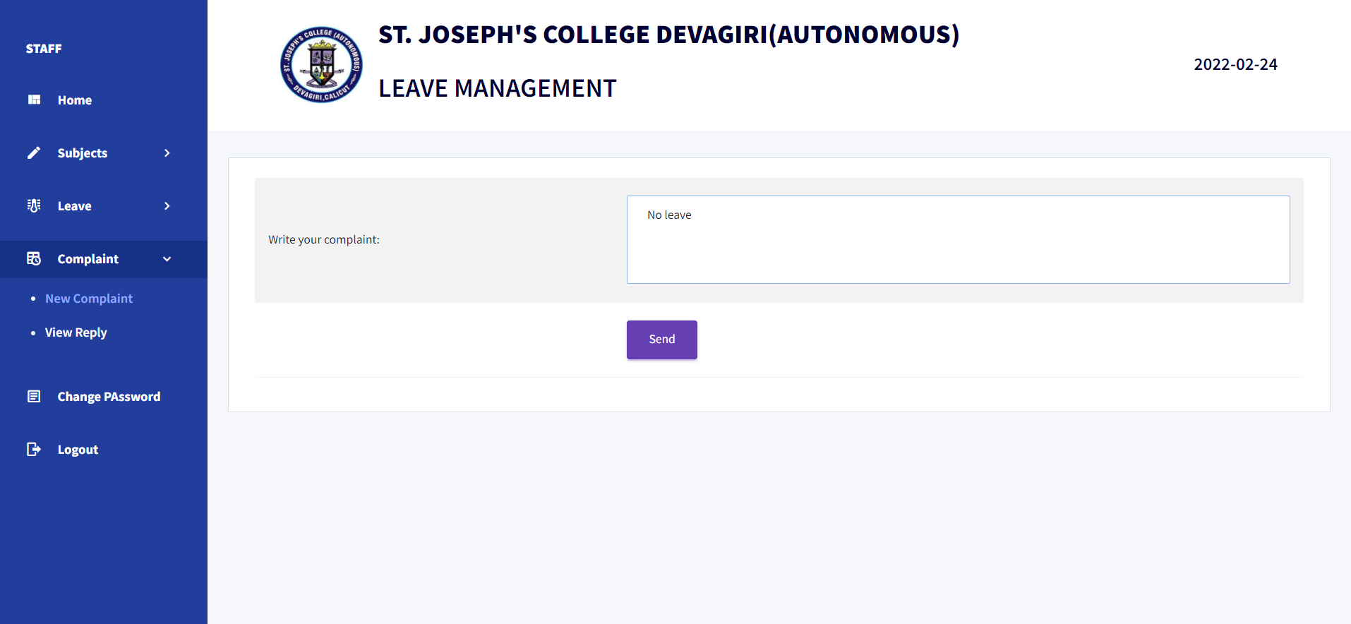
SEND COMPLAINT

Slide 53
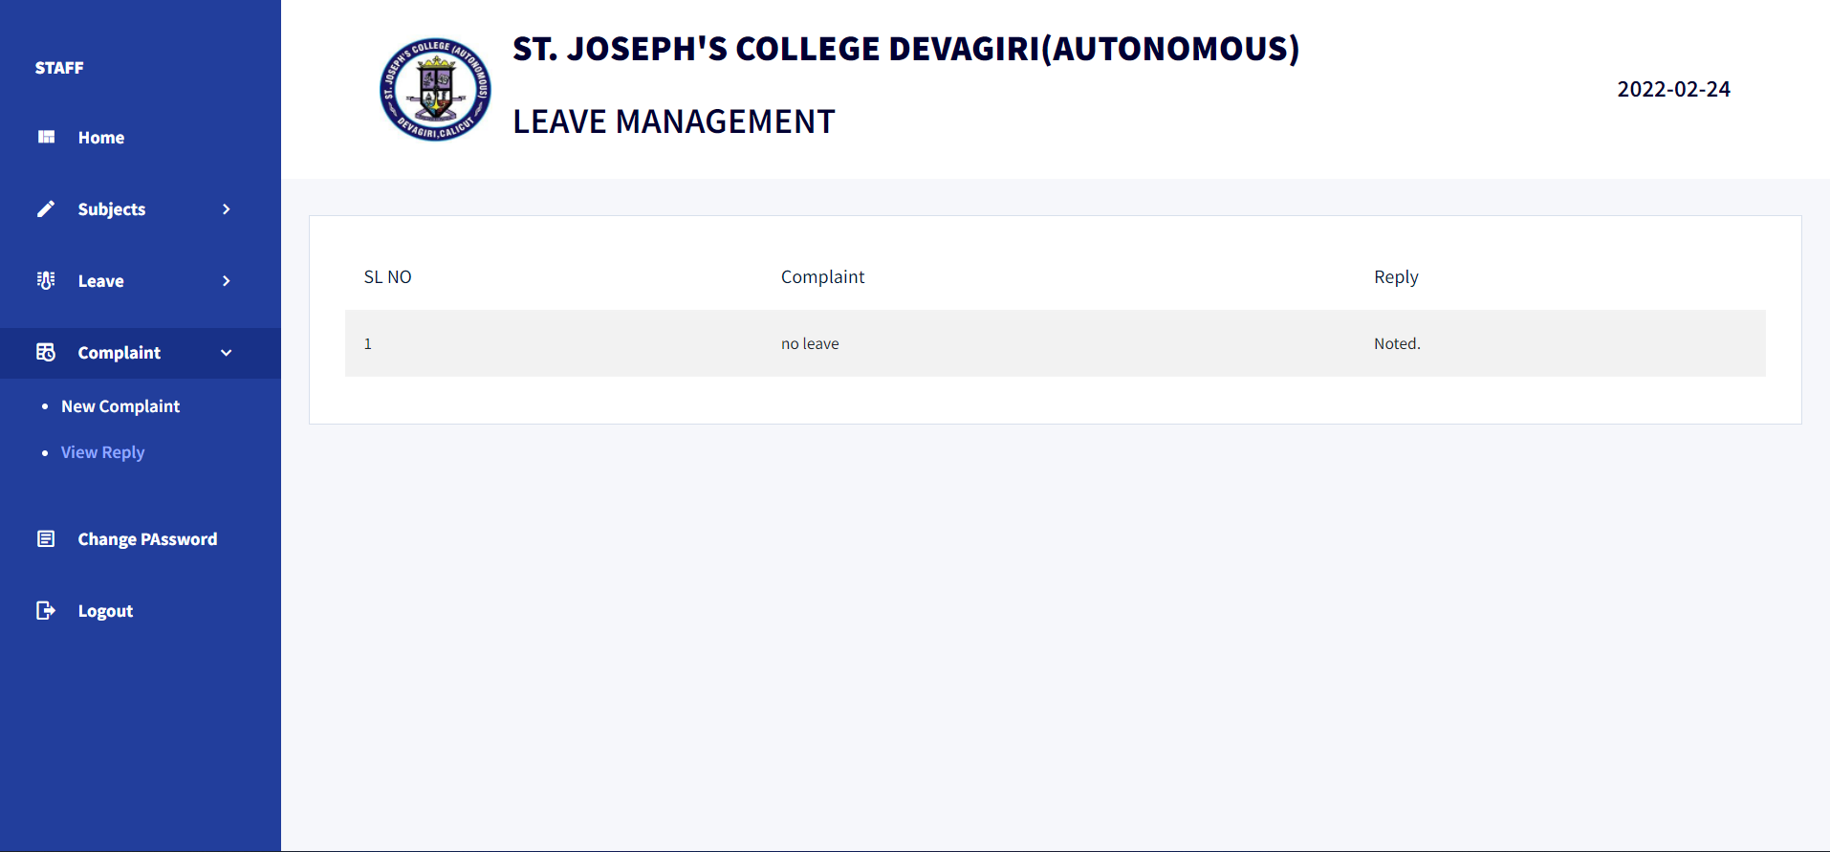
VIEW REPLY FROM ADMIN

Slide 54
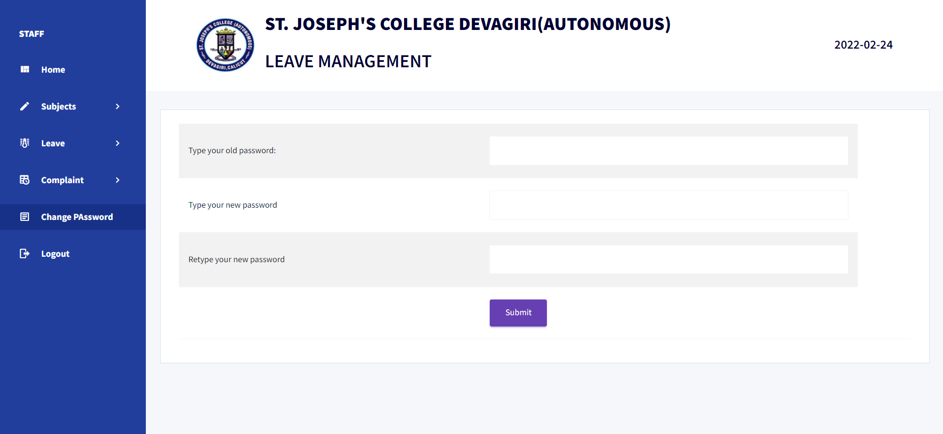
CHANGE PASSWORD

Slide 55
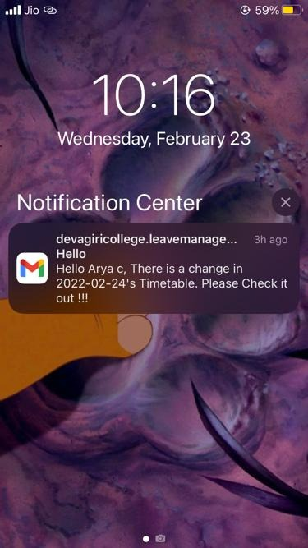
NOTIFICATION VIA E-MAIL

Slide 56
CONCLUSION

Slide 57
The goal of any good website or application is to make things that we do everyday a little easier. Our leave management project definitely fits this description- it simplifies the process of managing staff absences easier by using an algorithm that does all the work for them.
Our system saves time and effort because of this algorithm. The entire system digitalizes the process of applying for leave and accepting leave requests.
By making it a website, we simplify the process of applying for leave and assigning substitution available anywhere at anytime, with the click of a button.

Slide 58
THANK YOU

